Slide 1

Stochastic Models: Markov Chains
MTH 564 – Mathematical Modeling

Slide 2

Stochastic Models
In Part II of this course we covered deterministic dynamic models.
For these models if we know the system and the initial conditions, we can theoretically find the state of the system at any given time.
We used several techniques to study these including: Phase Portraits, Vector Fields, Eigenvalues, Simulation, etc.
With stochastic models we have an explicit representation of uncertainty.
The same set of parameter values and initial conditions may lead to different output states.
Models are typically indexed by time.
Probabilities are assigned to events (typically state changes) for the model
Used in Finance (Portfolio Analysis), Telecommunications (Traffic), Physics, Engineering, etc.

Slide 3
Markov Chains
Discrete time stochastic model
Generalizes the discrete time dynamical system models
Basically a sequence of random jumps between the states of the system
We only study models with a finite set of states
The key property is: The next state of the system depends ONLY on the current state.

Slide 4
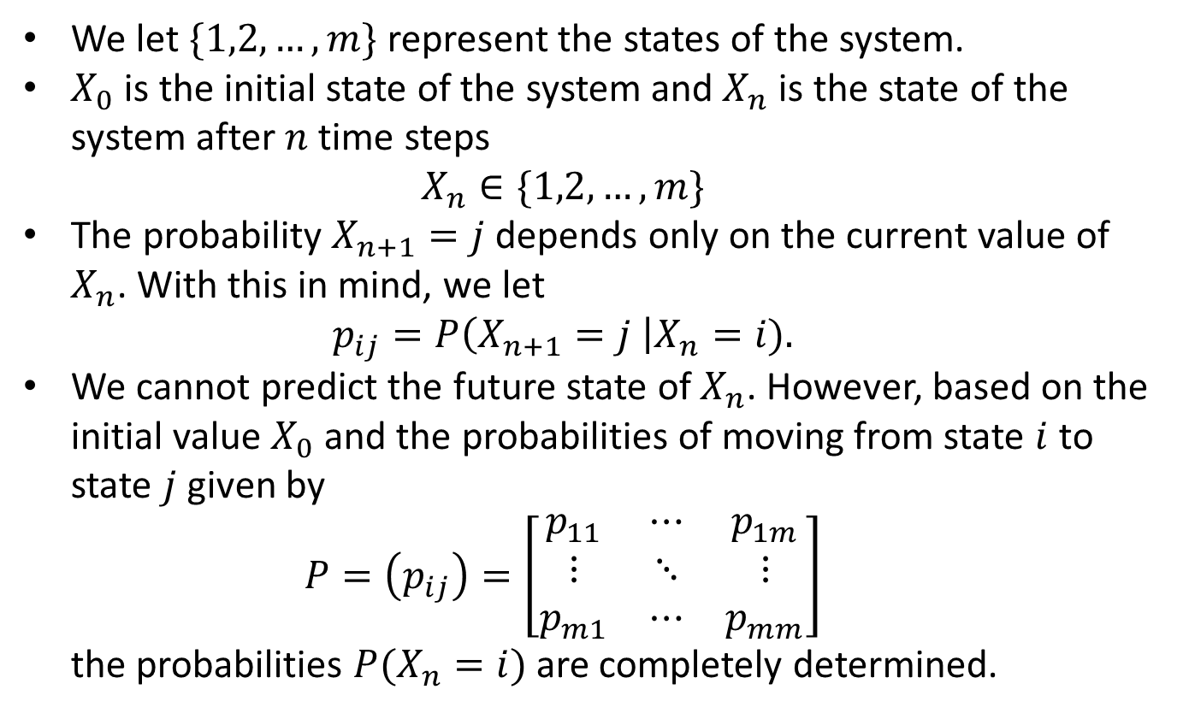
Markov Chains
We let $\{1,2,…, m\}$ represent the states of the system.
$X_{0}$ is the initial state of the system and $X_{n}$ is the state of the system after $n$time steps $X_{n}∈\{1,2,…,m\}$
The probability$X_{n+1}=j$ depends only on the current value of $X_{n}$. With this in mind, we let $p_{ij}=P\left(X_{n+1}=j \right|X_{n}=i).$
We cannot predict the future state of $X_{n}$. However, based on the initial value $X_{0}$ and the probabilities of moving from state $i$ to state $j$ given by $P=\left(p_{ij}\right)=\left[\begin{matrix}p_{11} & ⋯ & p_{1m} \\ ⋮ & ⋱ & ⋮ \\ p_{m1} & ⋯ & p_{mm}\end{matrix}\right]$ the probabilities $P(X_{n}=i)$ are completely determined.

Slide 5
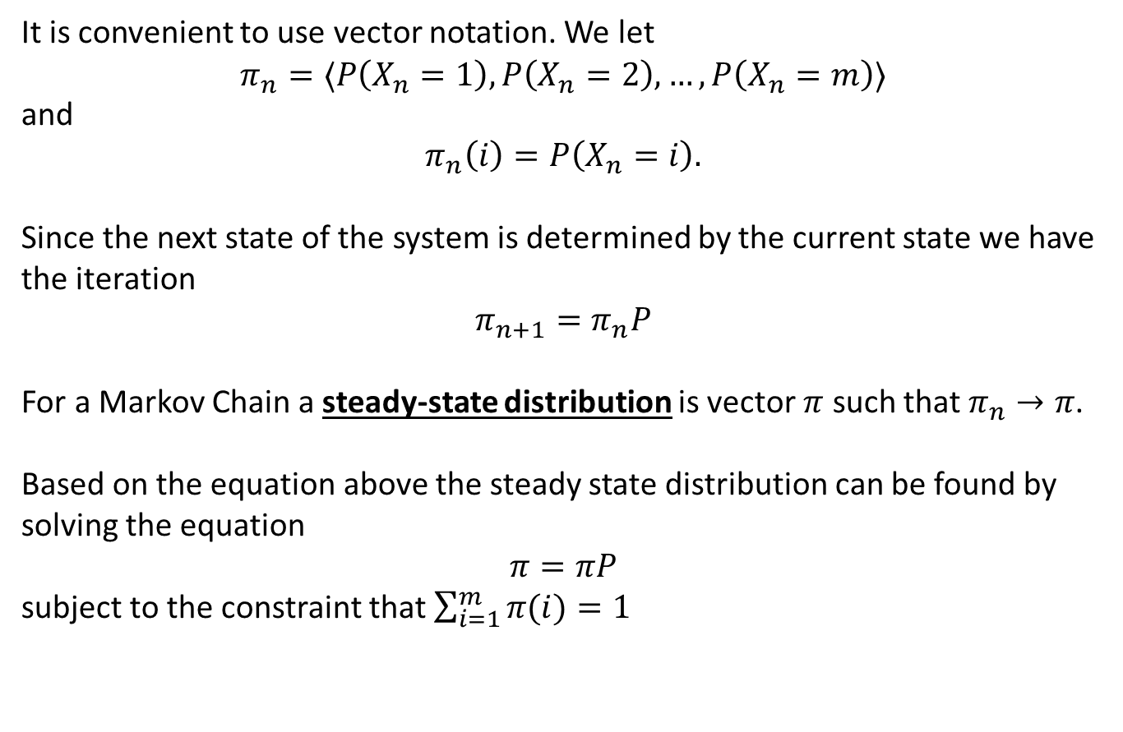
Markov Chains
It is convenient to use vector notation. We let
$$π_{n}=⟨P\left(X_{n}=1\right), P\left(X_{n}=2\right), …, P\left(X_{n}=m\right)⟩$$
and $$π_{n}\left(i\right)=P\left(X_{n}=i\right).$$
Since the next state of the system is determined by the current state we have the iteration
$$π_{n+1}=π_{n}P$$
For a Markov Chain a steady-state distribution is vector $π$ such that $π_{n}→π$.
Based on the equation above the steady state distribution can be found by solving the equation
$$π=πP$$
subject to the constraint that $\sum_{i=1}^{m}{π(i)}=1$

Slide 6
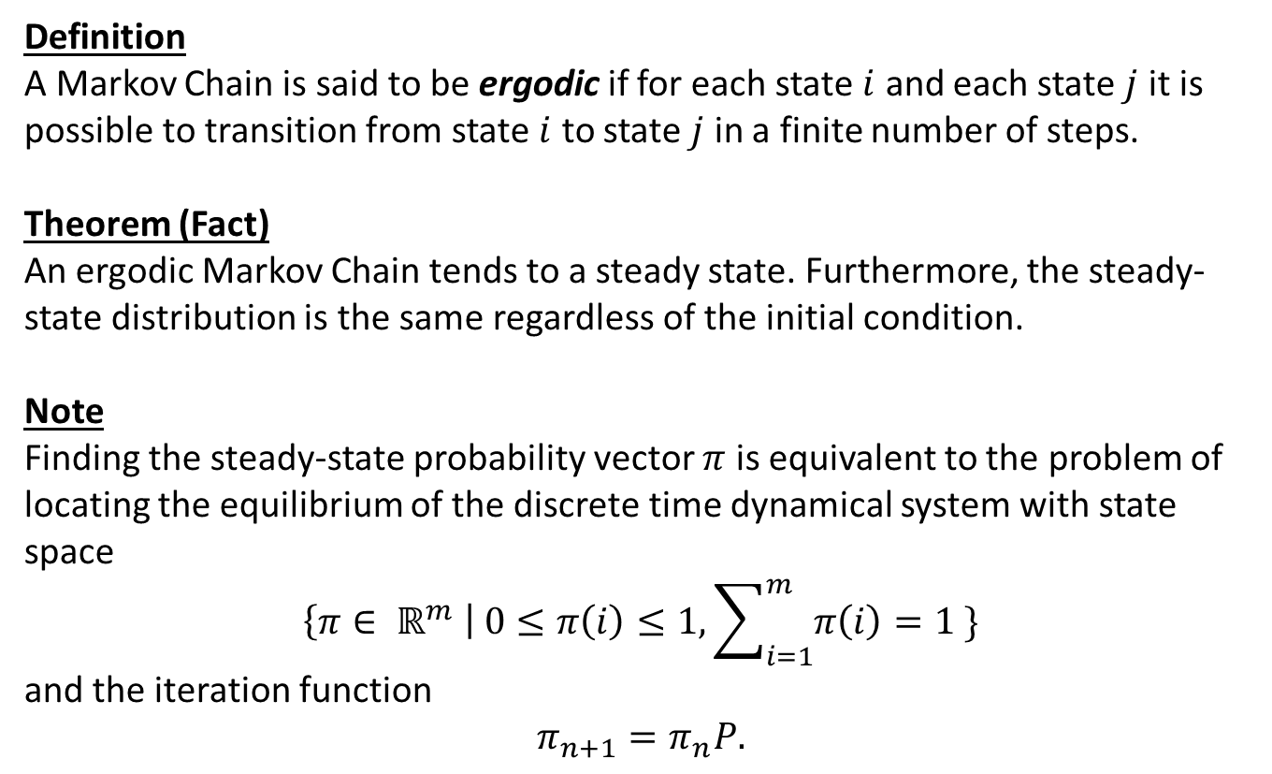
Markov Chains: Theorem
Definition
A Markov Chain is said to be ergodic if for each state $i$ and each state $j$ it is possible to transition from state $i$ to state $j$ in a finite number of steps.
Theorem (Fact)
An ergodic Markov Chain tends to a steady state. Furthermore, the steady-state distribution is the same regardless of the initial condition.
Note
Finding the steady-state probability vector $π$ is equivalent to the problem of locating the equilibrium of the discrete time dynamical system with state space
$$\left\{π∈ ℝ^{m} \right| 0≤π\left(i\right)≤1, \sum_{i=1}^{m}{π\left(i\right)=1} \}$$
and the iteration function
$$π_{n+1}=π_{n}P.$$

Slide 7
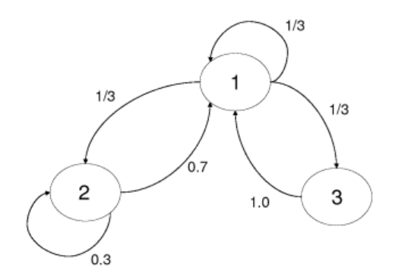
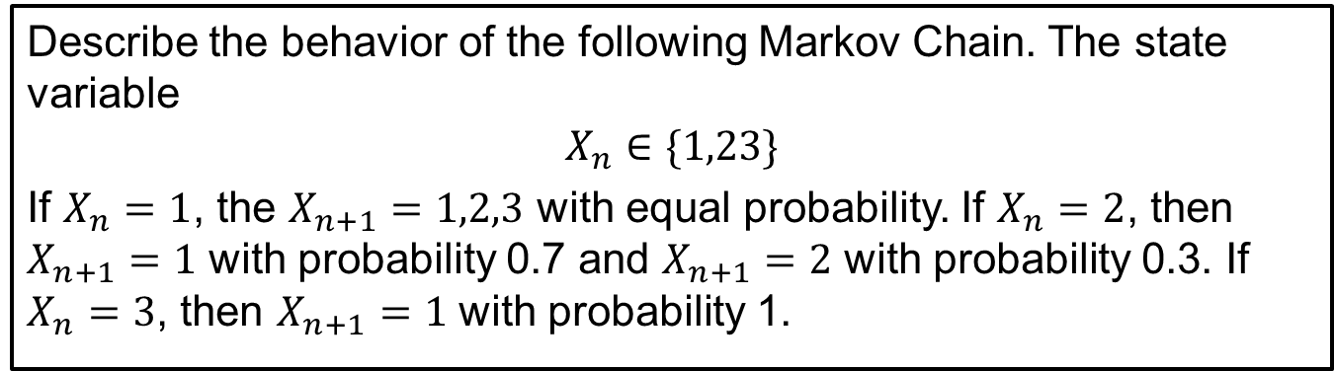
Example
Describe the behavior of the following Markov Chain. The state variable
$$X_{n}∈\{1,23\}$$
If $X_{n}=1$, the $X_{n+1}=1,2,3$ with equal probability. If $X_{n}=2$, then $X_{n+1}=1$ with probability 0.7 and $X_{n+1}=2$ with probability 0.3. If $X_{n}=3$, then $X_{n+1}=1$ with probability 1.
state transition diagram – allows us to visualize the Markov chain.
The nodes are states and the edges represent probabilities.

Slide 8
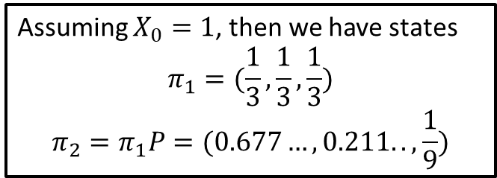
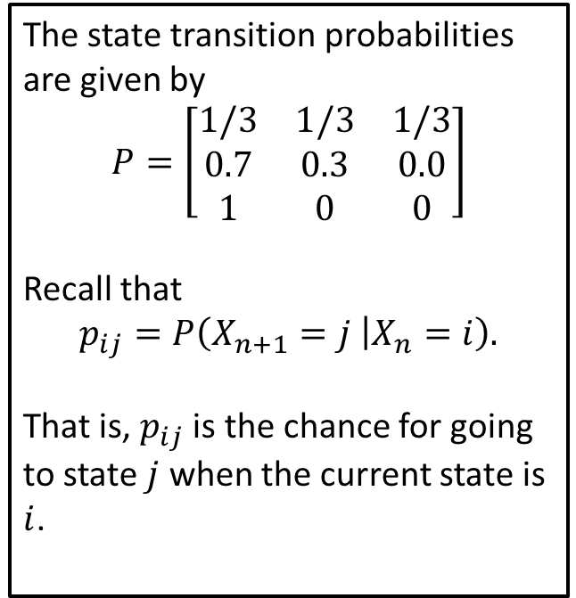
Example
The state transition probabilities are given by
$$P=\left[\begin{matrix}1/3 & 1/3 & 1/3 \\ 0.7 & 0.3 & 0.0 \\ 1 & 0 & 0\end{matrix}\right]$$
Recall that $$p_{ij}=P\left(X_{n+1}=j | X_{n}=i\right).$$
That is, $p_{ij}$ is the chance for going to state $j$ when the current state is $i$.
Assuming $X_{0}=1$, then we have states
$$π_{1}=(\frac{1}{3},\frac{1}{3},\frac{1}{3})$$
$$π_{2}=π_{1}P=(0.677…,0.211..,\frac{1}{9})$$

Slide 9
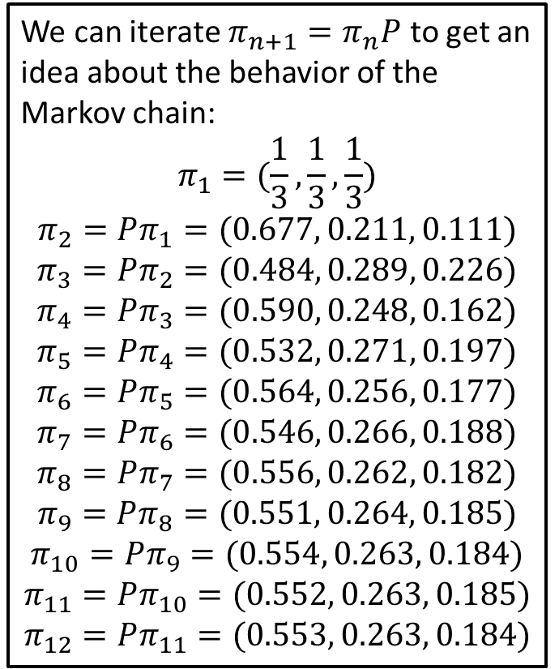
Iteration
We can iterate $π_{n+1}=π_{n}P$ to get an idea about the behavior of the Markov chain:
$$π_{1}=(\frac{1}{3},\frac{1}{3},\frac{1}{3})$$
$$π_{2}=Pπ_{1}=(0.677, 0.211, 0.111)$$
$$π_{3}=Pπ_{2}=(0.484, 0.289, 0.226)$$
$$π_{4}=Pπ_{3}=(0.590, 0.248, 0.162)$$
$$π_{5}=Pπ_{4}=(0.532, 0.271, 0.197)$$
$$π_{6}=Pπ_{5}=(0.564, 0.256, 0.177)$$
$$π_{7}=Pπ_{6}=(0.546, 0.266, 0.188)$$
$$π_{8}=Pπ_{7}=(0.556, 0.262, 0.182)$$
$$π_{9}=Pπ_{8}=(0.551, 0.264, 0.185)$$
$$π_{10}=Pπ_{9}=(0.554, 0.263, 0.184)$$
$$π_{11}=Pπ_{10}=(0.552, 0.263, 0.185)$$
$$π_{12}=Pπ_{11}=(0.553, 0.263, 0.184)$$
As we progress, the states do not change much and appear to be approaching a steady state.

Slide 10
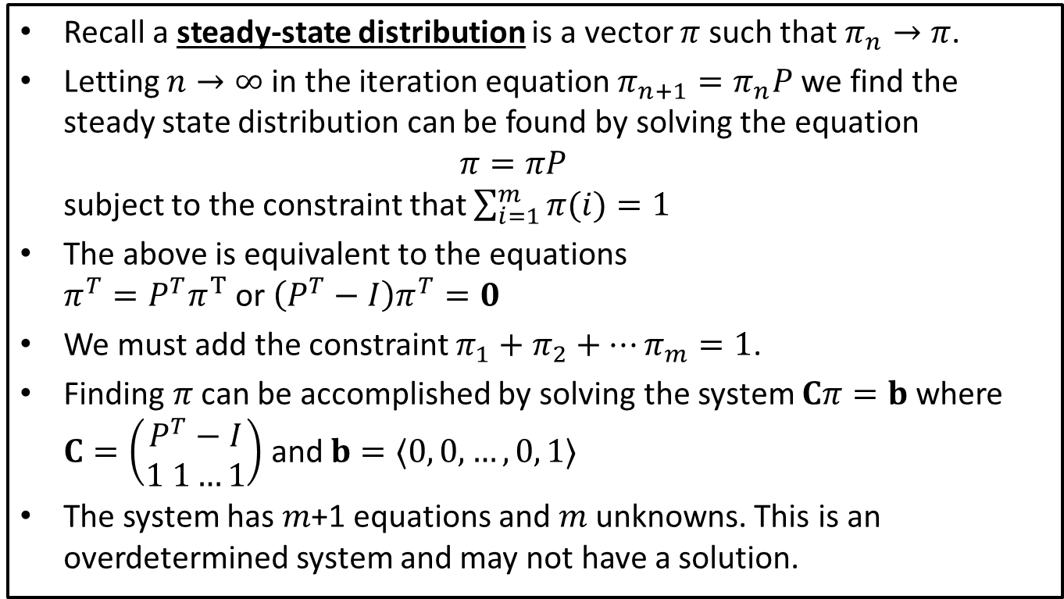
Steady State: Least Squares
Recall a steady-state distribution is a vector $π$ such that $π_{n}→π$.
Letting $n→∞$ in the iteration equation $π_{n+1}=π_{n}P$ we find the steady state distribution can be found by solving the equation $π=πP$ subject to the constraint that $\sum_{i=1}^{m}{π(i)}=1$
The above is equivalent to the equations $π^{T}=P^{T}π^{T}$ or $\left(P^{T}−I\right)π^{T}=0$
We must add the constraint $π_{1}+π_{2}+…π_{m}=1$.
Finding $π$ can be accomplished by solving the system $Cπ=b$ where $C=\left(\begin{aligned}P^{T}−I \\ 1 1…1\end{aligned}\right)$ and $b=⟨0, 0,…,0, 1⟩$
The system has $m$+1 equations and $m$ unknowns. This is an overdetermined system and may not have a solution.

Slide 11
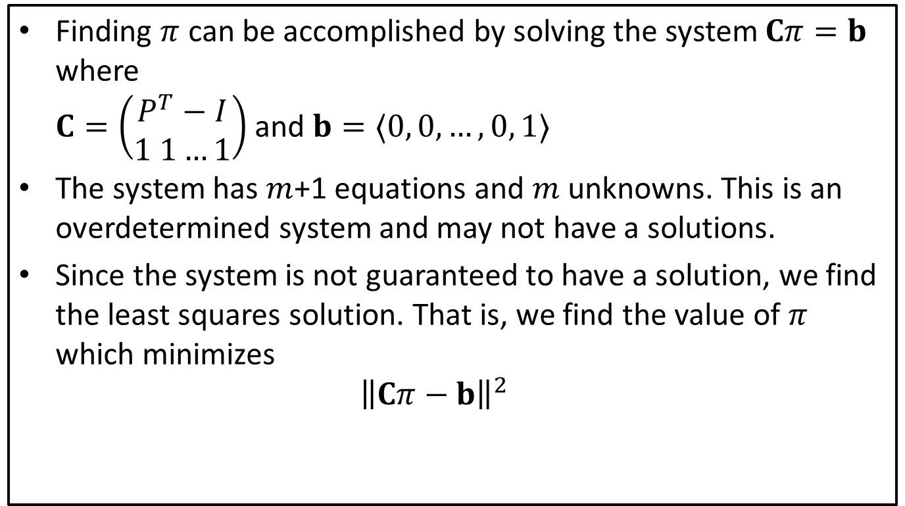
Steady State: Least Squares
Finding $π$ can be accomplished by solving the system $Cπ=b$ where $C=\left(\begin{aligned}P^{T}−I \\ 1 1…1\end{aligned}\right)$ and $b=⟨0, 0,…,0, 1⟩$
The system has $m$+1 equations and $m$ unknowns. This is an overdetermined system and may not have a solutions.
Since the system is not guaranteed to have a solution, we find the least squares solution. That is, we find the value of $π$ which minimizes ${\left\|Cπ−b\right\|}^{2}$

Slide 12
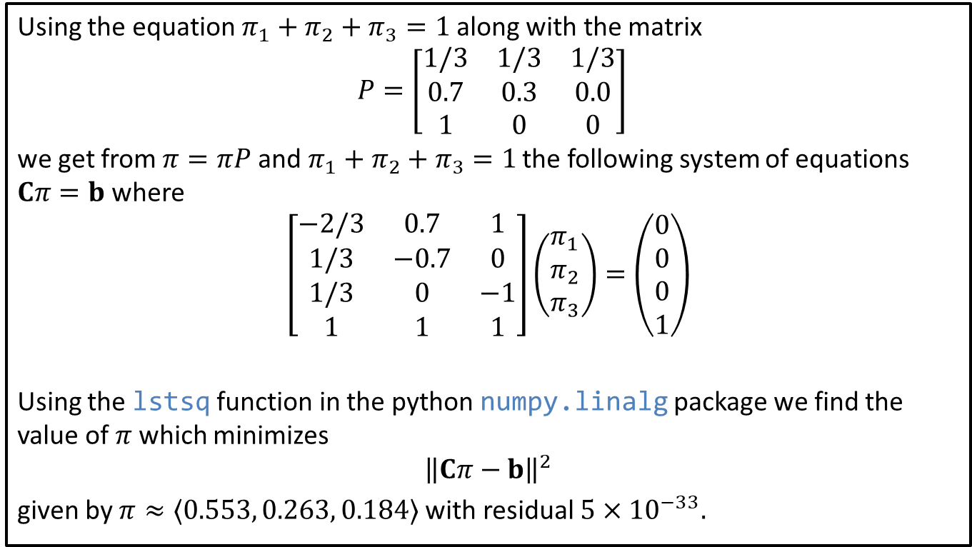
Examples: Least Squares
Using the equation $π_{1}+π_{2}+π_{3}=1$ along with the matrix
$$P=\left[\begin{matrix}1/3 & 1/3 & 1/3 \\ 0.7 & 0.3 & 0.0 \\ 1 & 0 & 0\end{matrix}\right]$$
we get from $π=πP$ and $π_{1}+π_{2}+π_{3}=1$ the following system of equations $Cπ=b$ where
$$\left[\begin{matrix}−2/3 & 0.7 & 1 \\ 1/3 & −0.7 & 0 \\ 1/3 & 0 & −1 \\ 1 & 1 & 1\end{matrix}\right]\left(\begin{matrix}π_{1} \\ π_{2} \\ π_{3}\end{matrix}\right)=\left(\begin{matrix}0 \\ 0 \\ 0 \\ 1\end{matrix}\right)$$
Using the lstsq function in the python numpy.linalg package we find the value of $π$ which minimizes $${\left\|Cπ−b\right\|}^{2}$$
given by $π≈⟨0.553, 0.263, 0.184⟩$ with residual $5×{10}^{−33}.$

